Slide 1
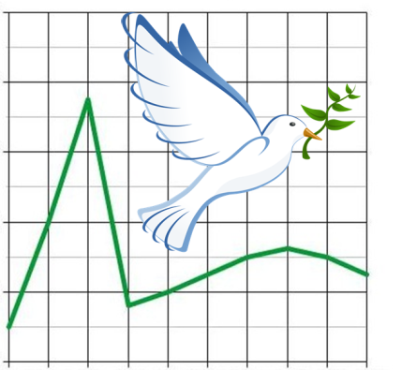
David J Corliss, PhD
COVID-19 Pandemic in the United States Disproportional Impact on Marginalized Communities
PhD Statistical Astrophysics,
Former Faculty
(= NOT a medical expert)
Founder and Director of Peace-Work: statistical volunteers for good causes
Peace-Work
Journal of Data Science
Business analytics manager, Commercial statistician since 1995
Presented in Webinar Series: Data Science in Action in Response to the Outbreak of COVID19

Slide 2
COVID-19 Pandemic in the United States Disproportional Impact on Marginalized Communities
David J Corliss, PhD
Peace-Work
Peace-Work

Slide 3
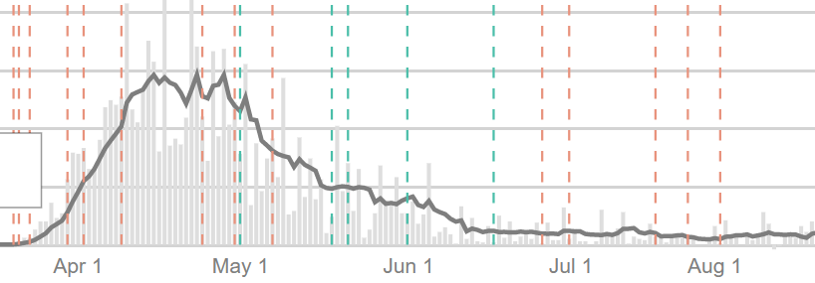
Analytic Methodology: Geographic Variation
Texas Florida
Michigan Illinois
Data Compilation and Plots: John Hopkins Coronavirus Center

Slide 4
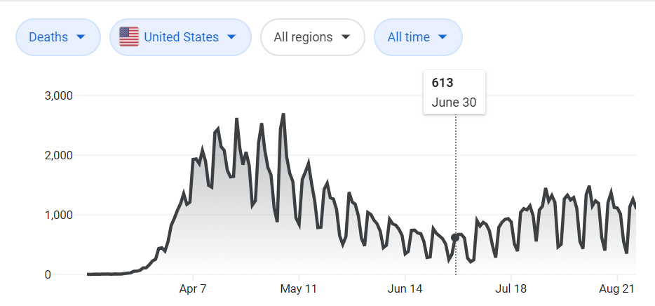
Analytic Methodology: 1st Wave Deaths / Capita
Deaths, not Cases
Per Capita
First Wave Only
County-Level (NYT Data)
Key Metric:
Cumulative Deaths Per Capita through 6/30
Data Compilation and Plot: Wikipedia

Slide 5
Early Evidence of Disproportional Impact
Detroit Area Early Trend – Deaths per 1,000,000
Michigan data indicated disproportionate impact by demographic factors

Slide 6
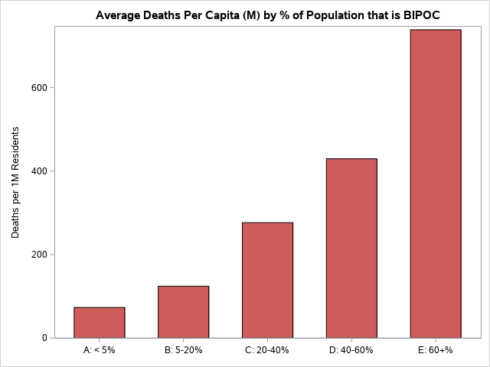
Statistical Results: % BIPOC Population
Impact steadily increases with increasing percent of BIPOC (Black, Indigenous, Persons of Color) residents at the county level

Slide 7
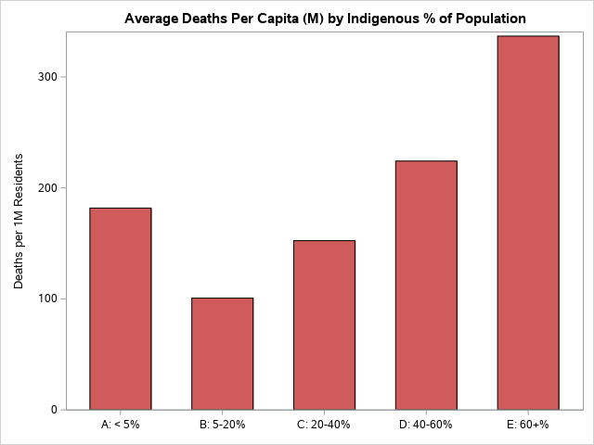
Statistical Results: % Indigenous Population
Similar trend seen in Indigenous only

Slide 8
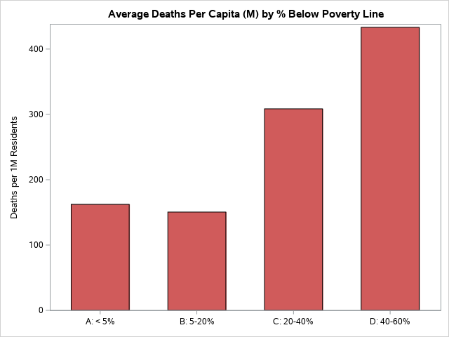
Statistical Results: % Below Poverty Line
COVID-19 death rate shows some correlation to % Poverty but not as marked as % BIPOC

Slide 9
Statistical Results: Odds Ratios
Odds Ratios of highest % prevalence (60%+) vs. lowest (<5%)
BIPOC | 10.1
Prison Populations* | 5.5
Indigenous | 3.3
Poverty | 2.9
Population Density | 1.9
* Compared to overall US population. Reported by Saloner et al, COVID-19
Cases and Deaths in Federal and State Prisons, JAMA, August 11, 2020

Slide 10
Summary
Disproportional impacts on marginalized populations are seen in COVID-19 1st Wave per capita deaths rates
COVID-19 per capita deaths rates increase with population percent for BIPOC and Indigenous groups
Higher death rates are also linked to higher poverty but not as strongly as higher percent of racial groups
Further investigation needed, especially for smaller populations and long-term effects

Slide 11
References and Resources
New York Times COVID-19 Data Repository
https://github.com/nytimes/covid-19-data
Johns Hopkins State Data Trends
https://coronavirus.jhu.edu/data/state-timeline
Prison Populations: Saloner, B. et al., JAMA. 2020;324(6):602-603. doi:10.1001/jama.2020.12528 https://jamanetwork.com/journals/jama/fullarticle/2768249
A Snapshot of How COVID-19 Is Impacting the LGBTQ Community
http://www.bu.edu/articles/2020/how-covid-19-is-impacting-the-lgbtq-community/
Analysis performed using SAS University Edition
https://www.sas.com/en_us/software/university-edition.html
Peace-Work – Studies and Other Information
https://www.peace-work.org/
8/28/2020

Slide 12
Questions?

Slide 13
Contact Information
David J Corliss
Peace-Work
734.8347.9323
davidjcorliss@gmail.com
www.peace-work.org

