Slide 1
Designing Against Bias in Machine Learning and AI
David J Corliss, PhD is the managing dIrector at Grafham Analytics, a data science consulting company. His work in best practices for ethical machine learning and AI includes chairing the 2022 Conference of Statistical Practice from the American Statistical Association (ASA), writing a column on Data for Good in the ASA’s monthly member magazine, and serves on the steering committee of the Statistics section of the American Association for the Advancement of Science. Dr. Corliss is the founder of Peace-Work, a volunteer cooperative of statisticians, data scientists and other researchers applying analytics in issue-driven advocacy.

Slide 2
Designing Against Bias: Identifying and Mitigating Bias in Machine Learning and AI
David J Corliss, Peace-Work
Modern Modeling Methods
University of Connecticut
June 27-28, 2023

Slide 3
OUTLINE
Overview of Bias in ML and AI
Root Causes of Bias
Measuring Bias
Designing Against Bias
Conclusions
Notes:
Outline

Slide 4
OVERVIEW OF BIAS IN ML AND AI

Slide 5
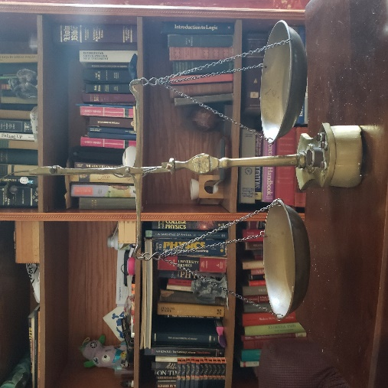
Bias in Machine Learning Algorithms
Taking human decisions out of the process was supposed to make things more fair…
…but often it hasn’t
=> What went wrong??

Slide 6
Racial Bias: Bail and Parole Algorithms
The “Solution”: ML says who gets bail or parole
COMPAS Algorithm:
RISK = AGE * Weight 1
+ AGE AT FIRST ARREST * Weight 2
+ HISTORY OF VIOLENCE * Weight 3
+ EDUCATION LEVEL * Weight 4
+ HISTORY OF NONCOMPLIANCE * Weight 5
The Problem: using the algorithm results in the exact same bias

Slide 7
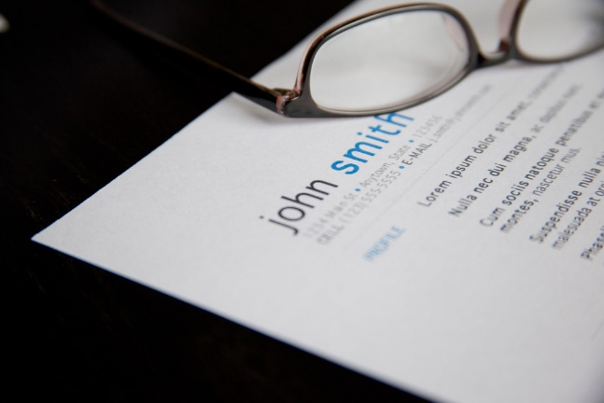
Gender Bias: Amazon Resume Screening
The “Solution”: ML picks top resumes
Amazon Algorithm:
Resume Quality = ? + ? + ? + ? + ? …
Image Credit: flazingo_photos - CC BY-SA 2.0
The Problem: the algorithm is biased against women applicants

Slide 8
ROOT CAUSES OF BIAS

Slide 9
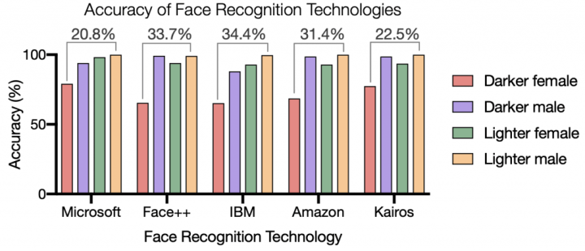
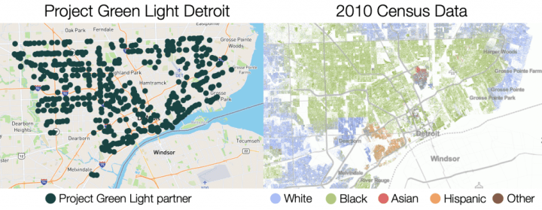
Root Causes of Bias: Selection Bias
Algorithm trained using biased subset
Data: Gender Shades Project Image Credit: Alex Najibi, Harvard University
Usage results in disparate impact
Image Credit: Alex Najibi, Harvard University
=> Biased Training Population = Biased Results

Slide 10
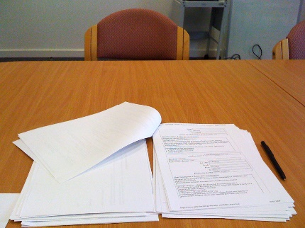
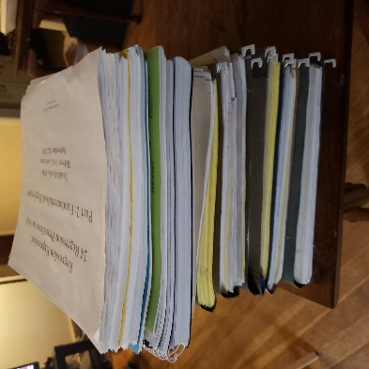
Root Causes of Bias: The History Problem
ML replaces human decision making
library(tensorflow)
library(keras)
model <- keras_model_sequential() %>%
layer_conv_2d(filters = 32,
kernel_size = c(3,3), activation = "relu",
Image Credit: David Davies -CC BY-SA 2.0
The algorithm is trained using earlier, biased human decisions
=> Bias In = Bias Out

Slide 11
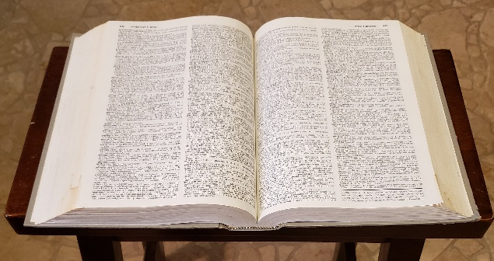
Root Causes of Bias: Spaghetti Problem
Hundreds or even thousands of potential predictors
DATA DICTIONARY
Algorithm trained uncritically using “anything that sticks”
Image Credit: snackdinner.com
=> Biased Predictors = Biased Outcome

Slide 12
STATISTICAL MEASURES OF BIAS

Slide 13
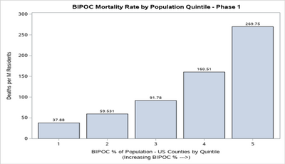
Measuring Bias: Disparate Impact
Example: COVID-19 Initial Mortality

Slide 14
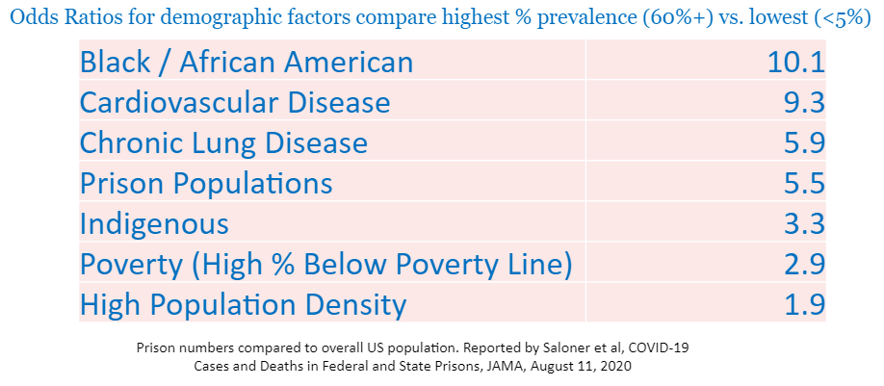
Measuring Bias: Disparate Impact

Slide 15
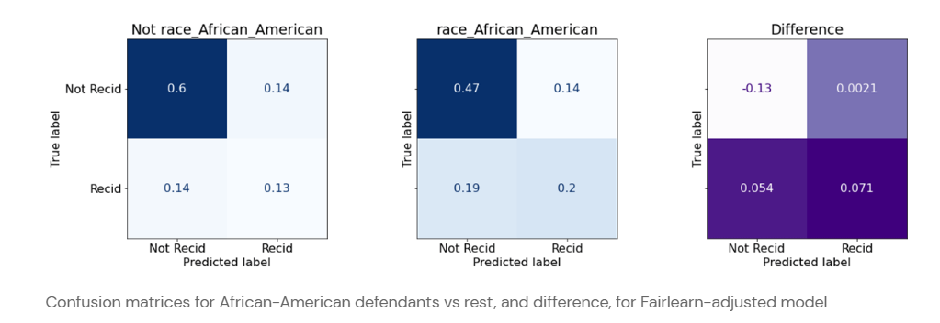
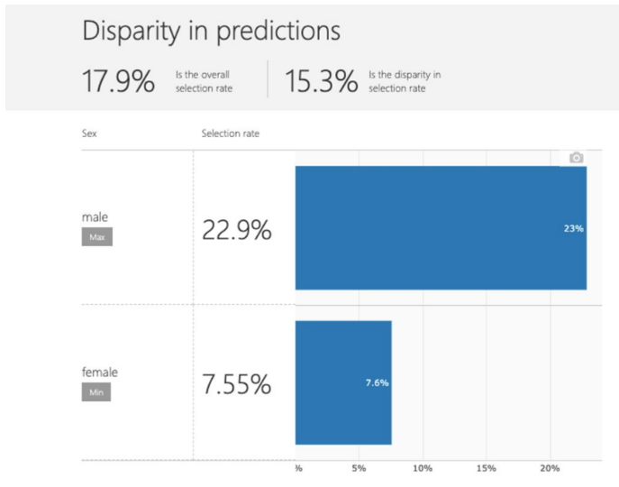
Measuring Bias: Fairlearn Algorithm

Slide 16
DESIGNING AGAINST BIAS IN ML AND AI

Slide 17
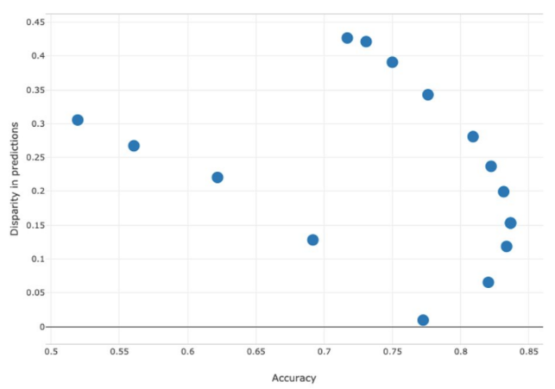
Designing Against Bias: Fairlearn

Slide 18
Designing Against Bias:
Bias-Minimized Comparison Algorithm
Develop a new predictive algorithm
Create a second model - the BMCA - by removing predictors that might confer bias
Test the new model against the BMCA to estimate the amount of bias in any variables causing concern

Slide 19
CONCLUSIONS

Slide 20
Best Practices for Design to Minimize Bias
Parsimonious Models
Screen all predictors for bias
Transparent Methods, not Black Box
Develop the model using new outcomes screened for bias - not past human decisions
Test for bias w/ FairLearn, BCMA, etc.
Present using Odds Ratios or Relative Risk
Open Source the data and algorithm

Slide 21
References
Corliss, D. (2021), Disproportional Impact of COVID-19 on Marginalized Communities, Proc. SAS Global Forum 2021
Dastin, J., (2018), Amazon scraps secret AI recruiting tool that showed bias against women, Reuters, October 2018 https://www.reuters.com/article/us-amazon-com-jobs-automation-insight/amazon-scraps-secret-ai-recruiting-tool-that-showed-bias-against-women-idUSKCN1MK08G
Hielbrun, L., Comment on testing using relative risk (personal communication), February 2023
Larson J., Mattu S., Kirchner L., Angwin J. (2016), How We Analyzed the COMPAS Recidivism Algorithm, ProPublica
https://www.propublica.org/article/how-we-analyzed-the-compas-recidivism-algorithm
Larson J., Mattu S., Kirchner L., Angwin J. (2016), COMPAS Recidivism Risk Score Data and Analysis, ProPublica
https://www.propublica.org/datastore/dataset/compas-recidivism-risk-score-data-and-analysis
Najibi, A. (2020), Racial Discrimination in Face Recognition Technology, Gender Shades Project, Harvard https://sitn.hms.harvard.edu/flash/2020/racial-discrimination-in-face-recognition-technology/
New York Times, Corona Virus County Data, New York Times, 2021
New York Times COVID-19 Data, accessed 10/8/2021: https://github.com/nytimes/covid-19-data
Owen, S. (2022), Mitigating Bias in Machine Learning With SHAP and Fairlearn, Databricks https://www.databricks.com/blog/2022/09/16/mitigating-bias-machine-learning-shap-and-fairlearn.html
US Census Bureau Demographic Data
https://www.census.gov/programs-surveys/ces/data/restricted-use-data/demographic-data.html

Slide 22
Questions?
David J Corliss, PhD
Peace-Work
E-mail: davidjcorliss@peace-work.org

